Slide 1
Data mining and data linking

Slide 2

Notes:
Publication is a closed object

Slide 3
PDFs pros and cons
You get to keep the PDF
Lots of PDF readers
The PDF has everything (e.g., images, not like a web page where these are separate)
PDF is the “version of record”
PDF is hard for computers to read
Data gets locked up as images (e.g., phylogenies)

Slide 4
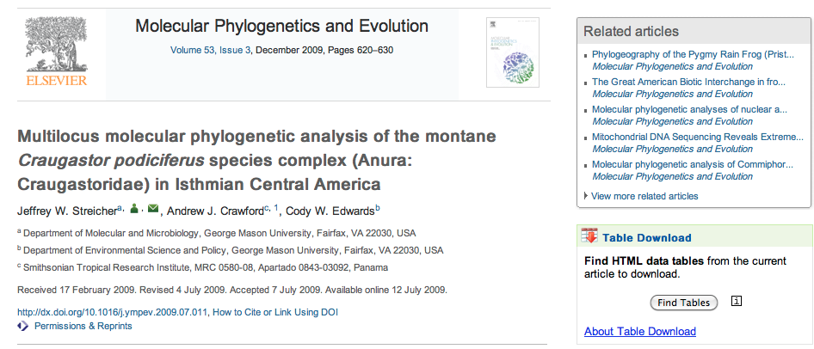
Getting data from papers (beyond the PDF)
http://dx.doi.org/10.1016/j.ympev.2009.07.011

Slide 5

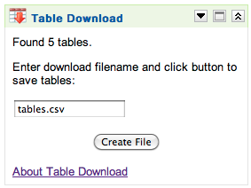
Extracting tables

Slide 6
Tables from paper as comma separated values (CSV)
Taxon and institutional vouchera,Locality ID,Collection locality,Geographic coordinates/approximate location,Elevation (m),GenBank accession number 12S,16S,COI,c-myc
1. UTA A-52449,1,"Puntarenas, CR","(10°18′N, 84°48′W)",1520,EF562312,EF562365,None,EF562417
2. MVZ 149813,2,"Puntarenas, CR","(10°18′N, 84°42′W)",1500,EF562319,EF562373,EF562386,EF562430
3. FMNH 257669,1,"Puntarenas, CR","(10°18′N, 84°47′W)",1500,EF562320,EF562372,EF562380,EF562432
4. FMNH 257670,1,"Puntarenas, CR","(10°18′N, 84°47′W)",1500,EF562317,EF562336,EF562376,EF562421
5. FMNH 257671,1,"Puntarenas, CR","(10°18′N, 84°47′W)",1500,EF562314,EF562374,EF562409,None
6. FMNH 257672,1,"Puntarenas, CR","(10°18′N, 84°47′W)",1500,EF562318,None,EF562382,None

Slide 7
Cleaning data

Slide 8
(10°18’ N, 84°42’ W)
2. MVZ 149813,2,"Puntarenas, CR","(10°18′N, 84°42′W)",1500,EF562319,EF562373,EF562386,EF562430
We can read this, but a computer would prefer just numbers

Slide 9

Tools for cleaning data
Spreadsheets like Excel and Google Docs can be used to clean data using simple formula (such as combining cells)
Open Refine offers regular expressions, filtering, and the ability to call external services

Slide 10
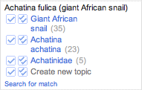
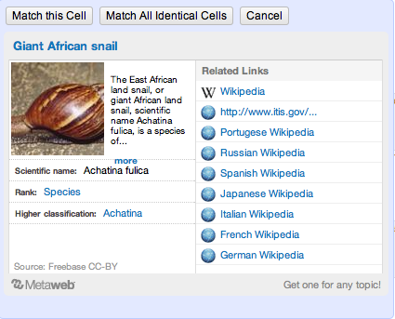
Achatina fulica (giant African snail)

Slide 11
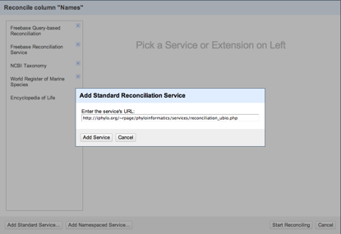
Reconciliation services
Services that Open Refine can use to match things like taxonomic names

Slide 12
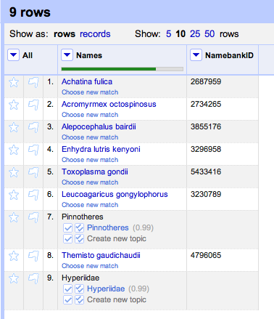
Names reconciled using uBio and Open Refine

Slide 13
What can we do with text mining?

Slide 14
Extract information on ecological relationships

Slide 15
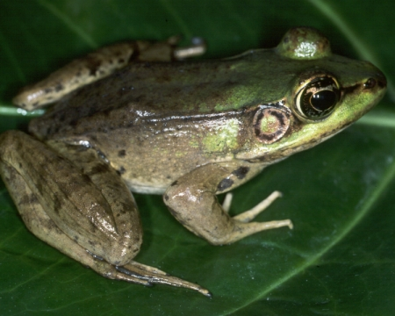

Slide 16
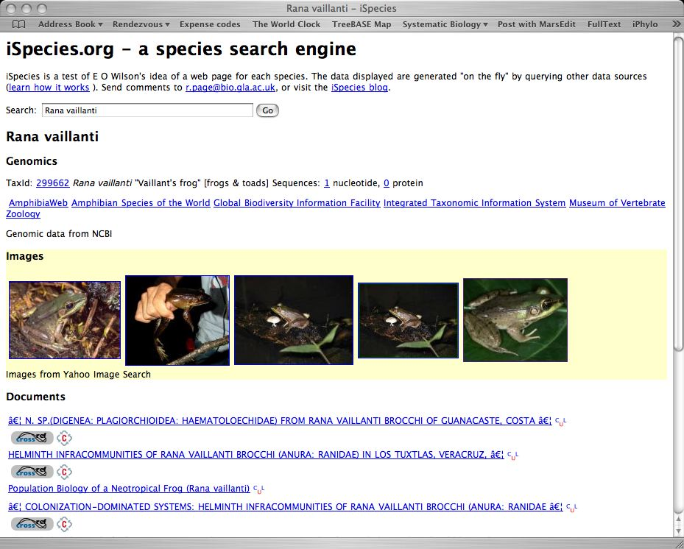
Text mining

Slide 17
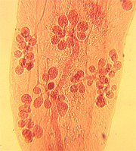
Morphological and molecular description of Haematoloechus meridionalis n. sp. (Digenea: Plagiorchioidea: Haematoloechidae) from Rana vaillanti brocchi of Guanacaste, Costa Rica
Halipegus eschi n. sp. (Digenea: Hemiuridae) in Rana vaillanti from Guanacaste Province, Costa Rica
Haematoloechus danbrooksi n. sp. (Digenea: Plagiorchioidea) from Rana vaillanti from Los Tuxtlas, Veracruz, Mexico

Slide 18
<parasite name> (n. sp.) from <host name>

Slide 19
Sources of host-parasite associations
Titles of papers
Sequence databases (GenBank)

Slide 20
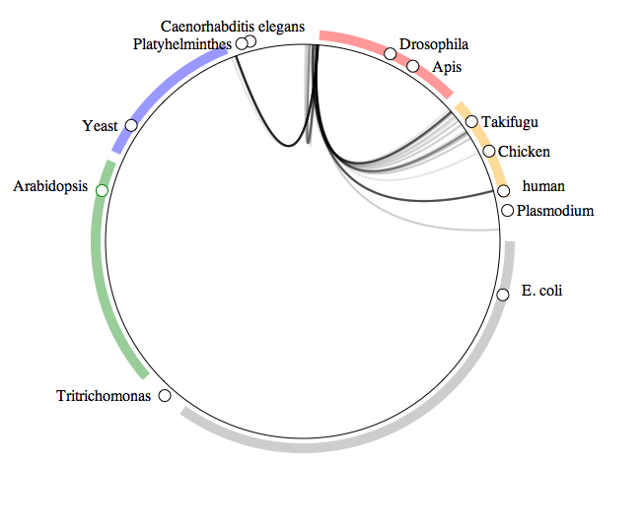
What do crustaceans live on?
Arthropods
Fungi
Vertebrates
Green
plants
Bacteria

Slide 21
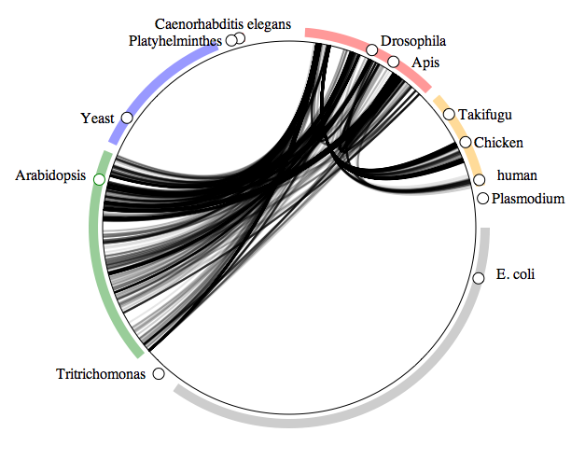
What do insects live on?
Arthropods
Fungi
Vertebrates
Green
plants
Bacteria

Slide 22
Host names in GenBank
acorn gall on Quercus pyrenaica
Aconitum napellus
Aconitum napellus L.
Acinonyx jubatus (Cheetah)
Actinidia chinensis Hort 16A
Alces alces (intermediate host)
alfalfa

Slide 23
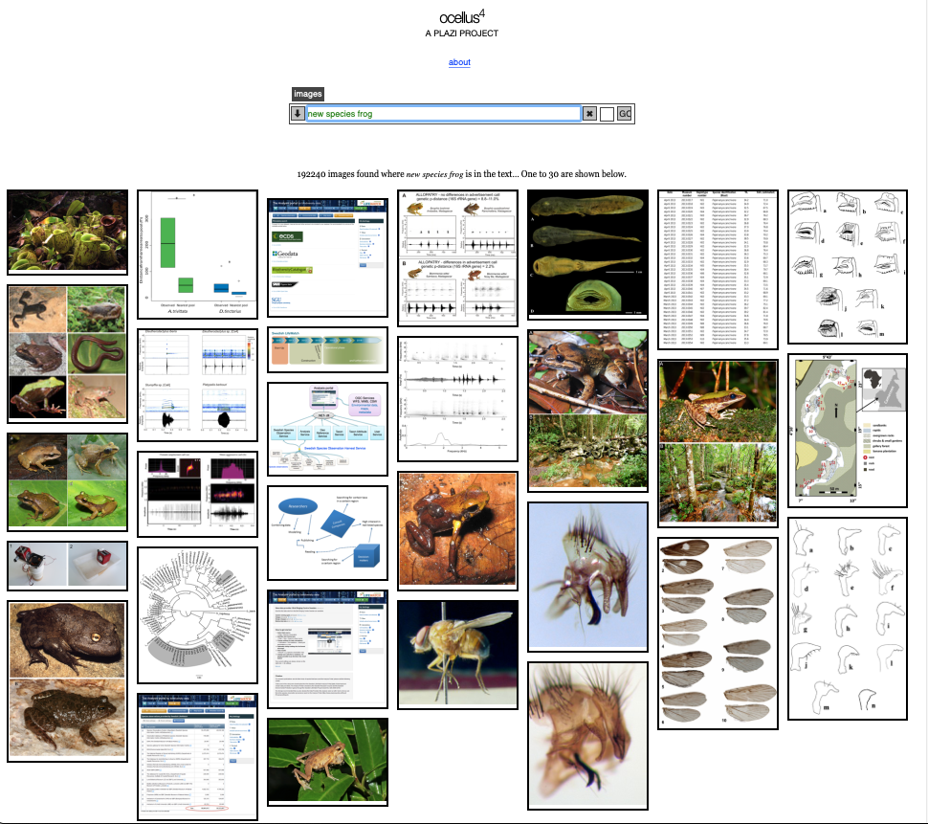
Extracting images

Slide 24
Is this legal?
We conclude that copyright does not apply to most images in taxonomic literature because they are presented in a standardized way and lack the individuality that is required to qualify as ‘copyrightable works’.
It follows that most images found in taxonomic literature can be re-used for research or many other purposes without seeking permission, regardless of any copyright declaration.
https://doi.org/10.3897/rio.3.e12502

Slide 25
Extracting links between data sets

Slide 26

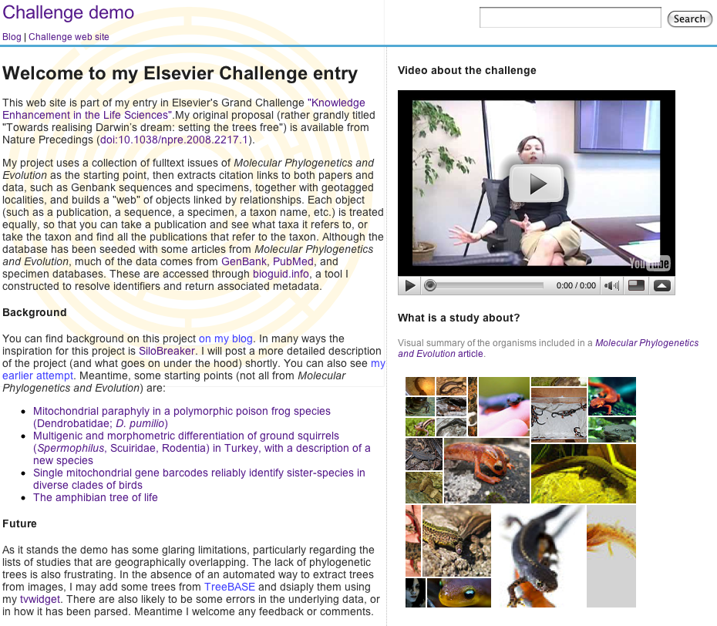
http://iphylo.org/~rpage/challenge

Slide 27
Notes:
Publication is a closed object

Slide 28
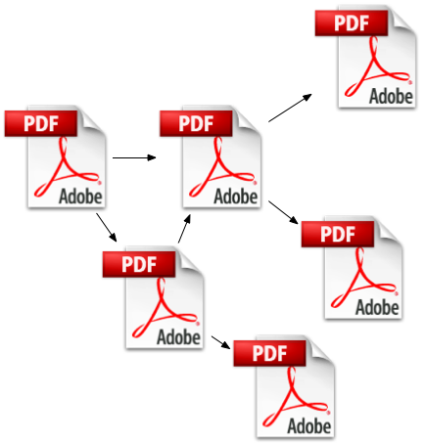
Citation links between papers
Notes:
All the same thing

Slide 29
Are there other kinds of links?

Slide 30
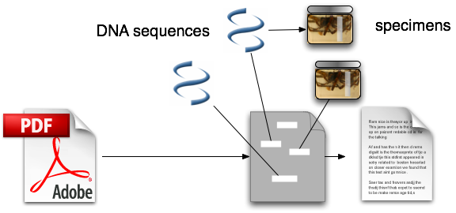
data linking
Notes:
Citation, user sees bibliography and may be able to follow links

Slide 31
Extracting these links
Look for Genbank sequences
Look for specimen identifiers
Look for taxonomic names
Look for geographic localities

Slide 32
Regular expressions to the rescue!

Slide 33
Regular expressions
Rules for matching strings
Allow for approximate or variable matches
More flexible than “search and replace”
[0-9]{4} matches a string with four digits (such as a year)

Slide 34
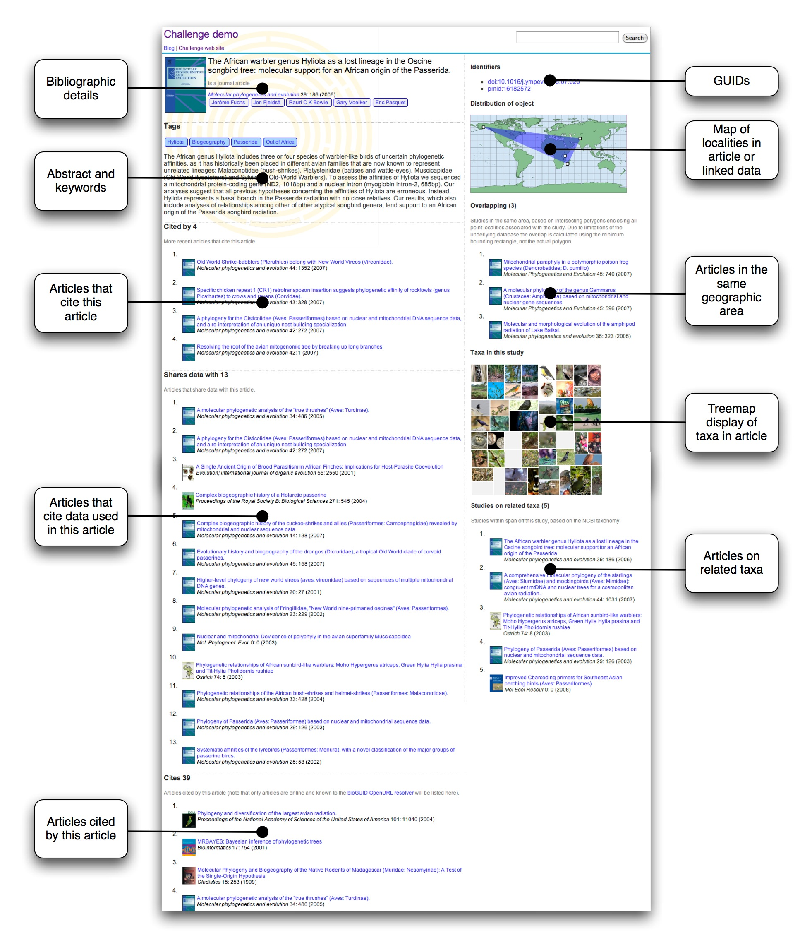
demo

Slide 35
Perils of data mining
(matching the wrong things)

Slide 36
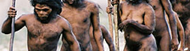

Taxa found in one paper
Image search on taxonomic name

Slide 37
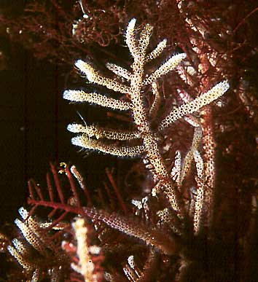
Electra pilosa

Slide 38
Carmen Electra versus Electra
(guess which one is more popular?)

Slide 39
But what about this?

Slide 40
Homo sapiens

Slide 41
AJ711044

Slide 42
should be AJ971044

Slide 43
Stable links between things (identifiers)
(what if they were made for us?)

Slide 44
Digital Object Identifier (DOI)

Slide 45


Slide 46
Identifies a publication

Slide 47
Globally unique

Slide 48
10.1016/j.ympev.2006.04.006

Slide 49
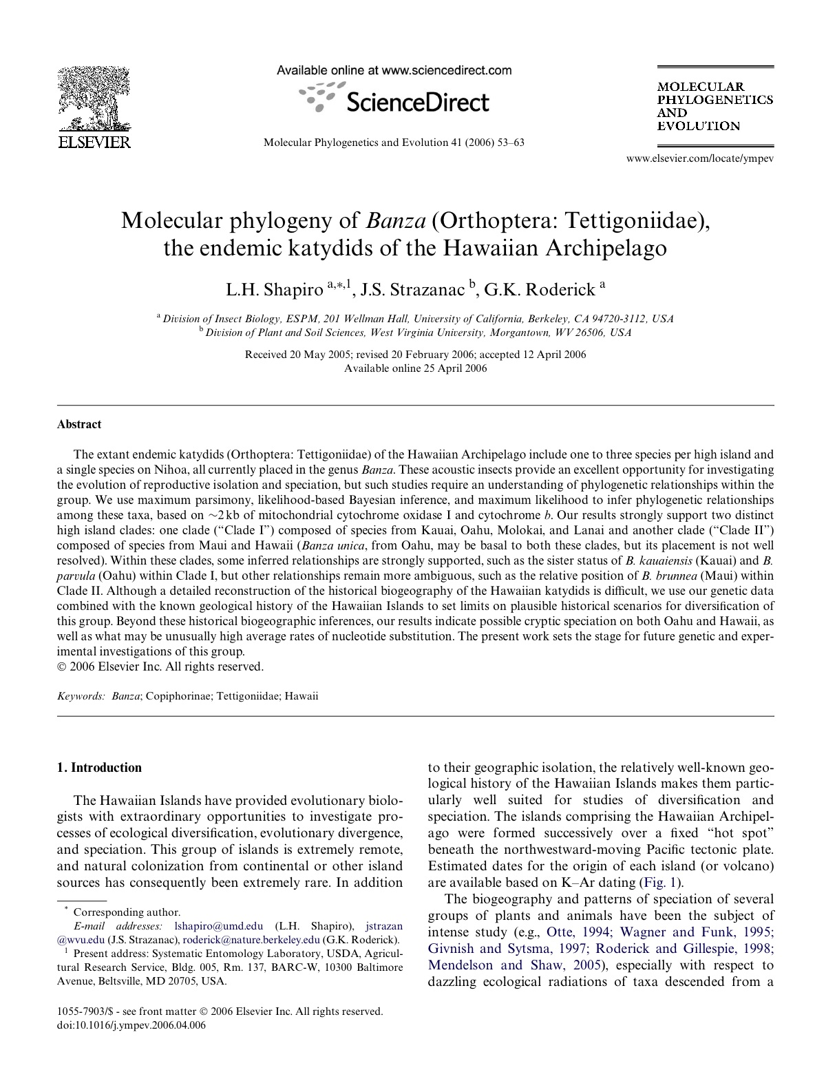
Paper

Slide 50
Why have DOIs?

Slide 51
Link rot

Slide 52
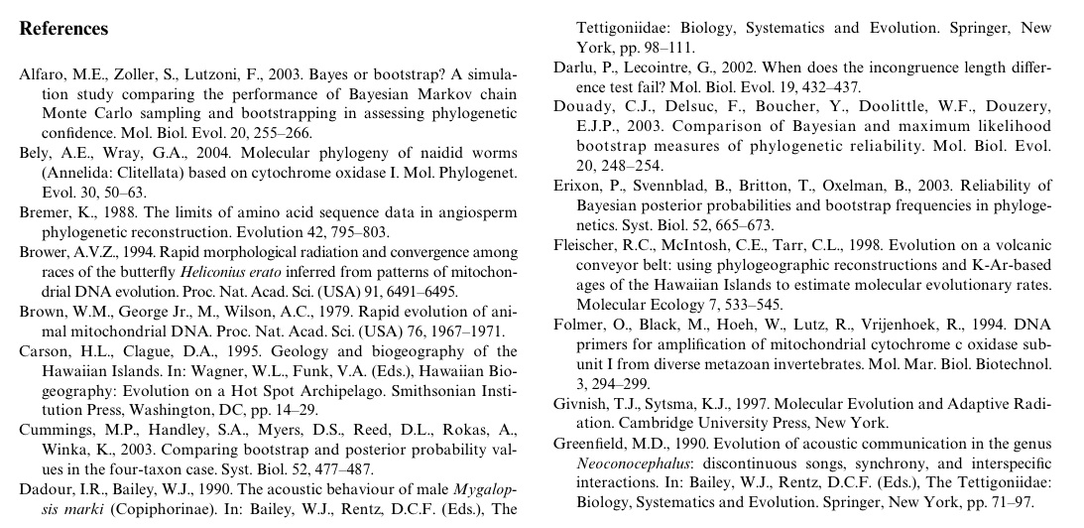
Refs

Slide 53





Slide 54


Slide 55
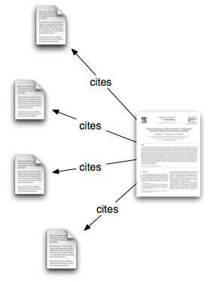
Cites
2006
2006

Slide 56
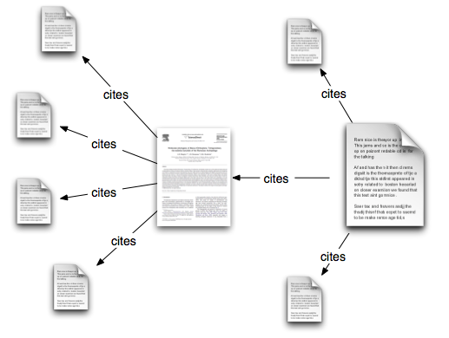
Forward Cites
2006
2009

Slide 57
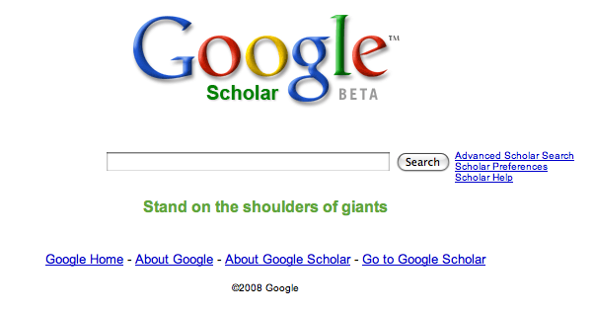
Shoulders of giants

Slide 58
progress is incremental

Slide 59
reuse past results

Slide 60
Forward Cites
2006
2008

Slide 61
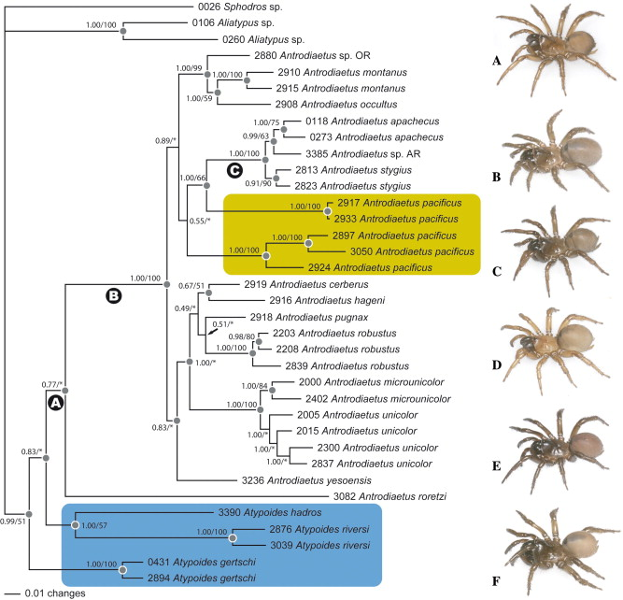
Notes:
~/Desktop/GrandChallenge/Data/DVD/LAB0370A/10557903/00420003/06003691/main.xml

Slide 62
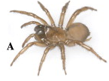

Species
Genes

Slide 63
data linking
Notes:
Citation, user sees bibliography and may be able to follow links

Slide 64
Data citation
Giving credit for more than just writing a paper

Slide 65
Linking all the things!
Giving credit for more than just writing a paper

Slide 66
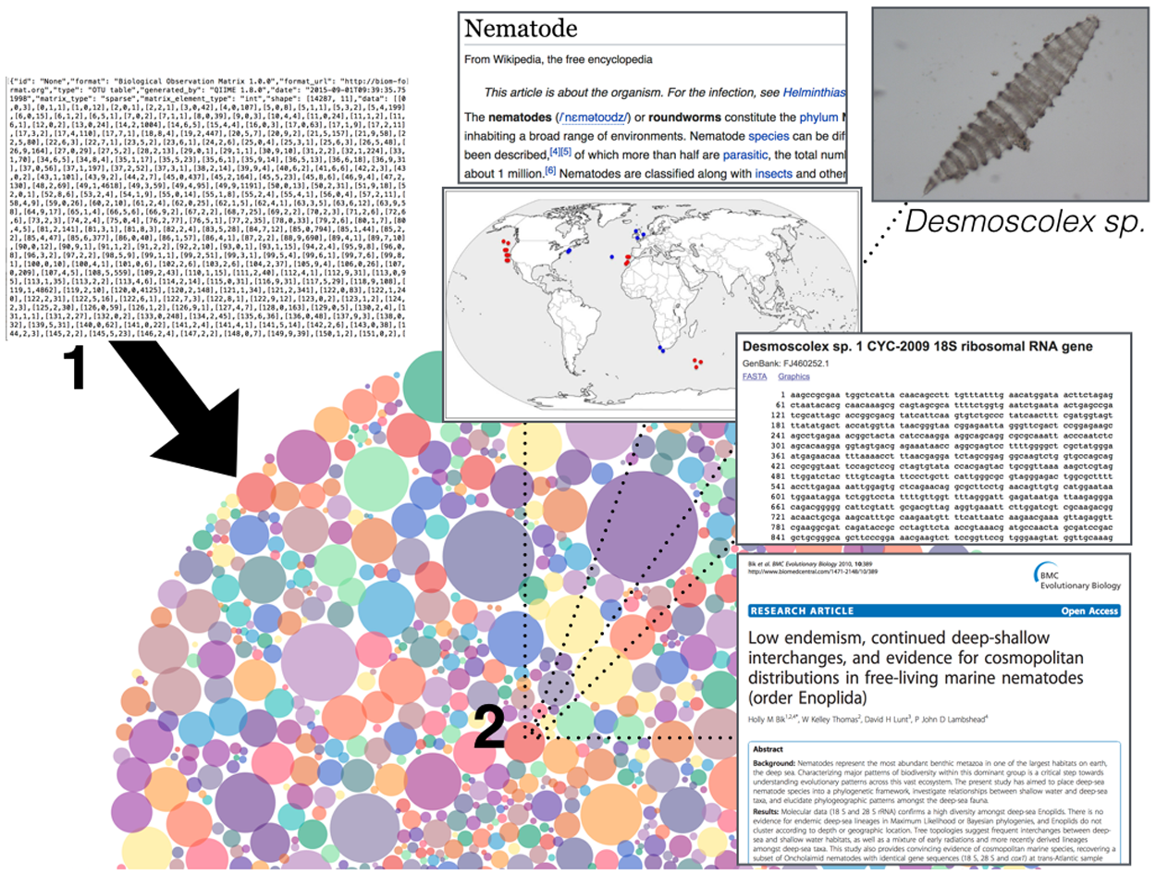
@hollybik Holly Bik
Let’s rise up to unite taxonomy and technology
https://doi.org/10.1371/journal.pbio.2002231
Notes:
https://doi.org/10.1371/journal.pbio.2002231

Slide 67
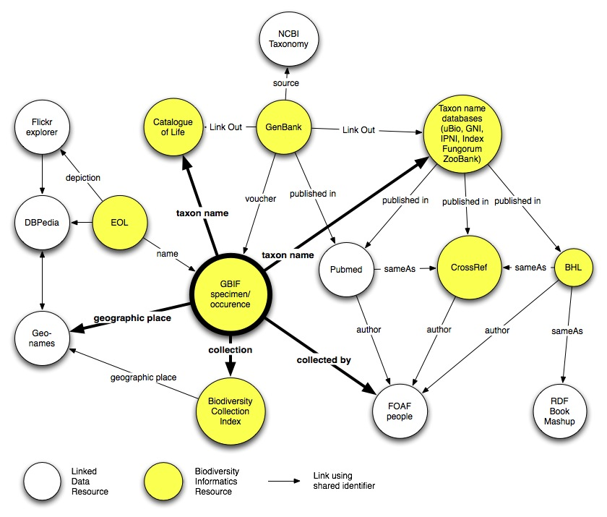

Slide 68
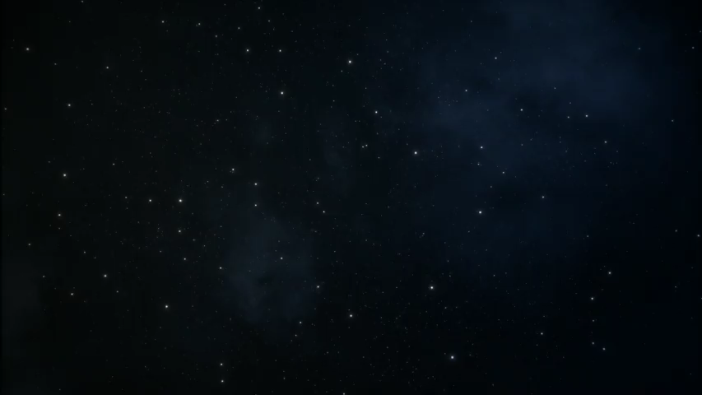

Slide 69
BBC Wildlife
BBC nature programmes are rich in information
There used to be BBC web pages that listed plants and animals in the programmes, described their biology, and linked to clips of BBC content
Now these pages are gone ☹

Slide 70
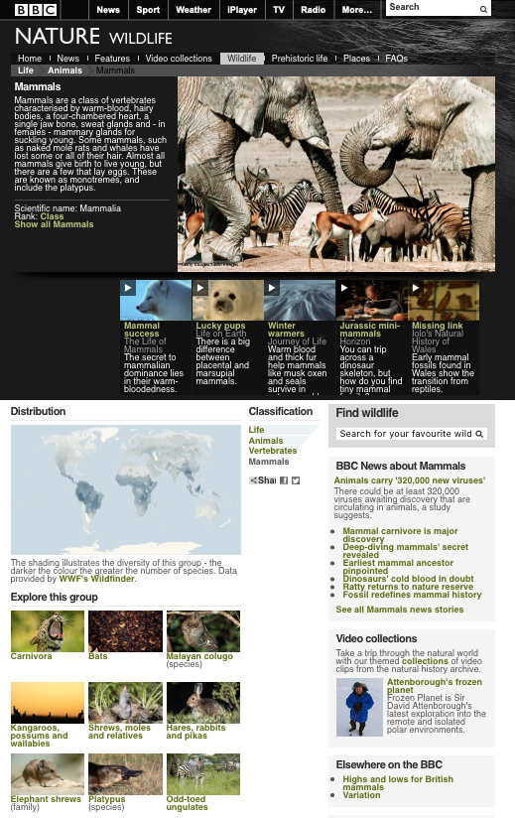

Slide 71
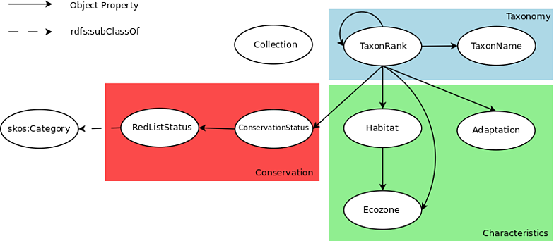
BBC Wildlife

Slide 72
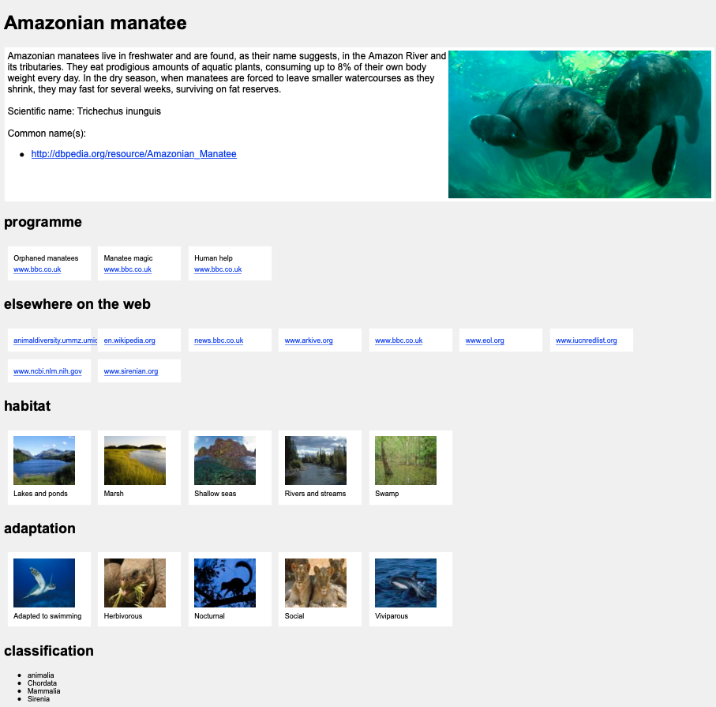
BBC Wildlife, reimagined
Data from old BBC web site used to create simple app where you can view organisms by ecology, distribution, etc.

Slide 73

Notes:
https://www.wikidata.org

Slide 74
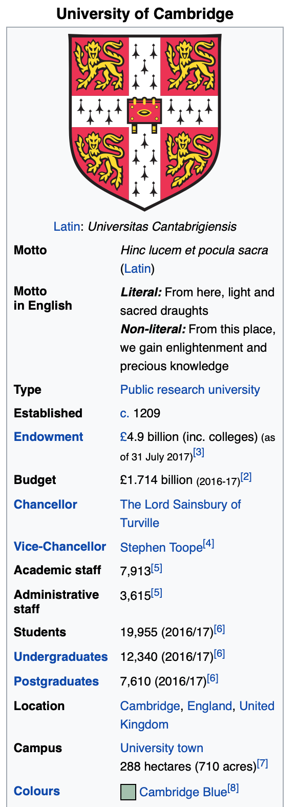
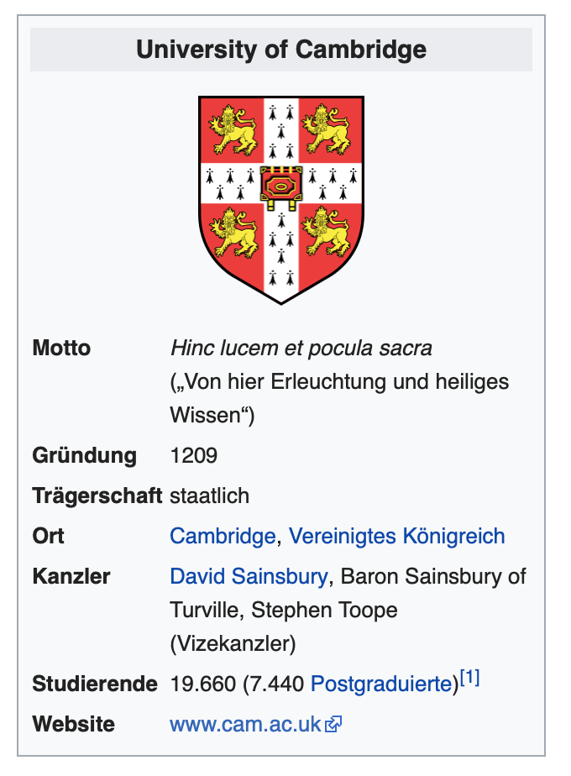
Wikipedia has a data problem
How many students go to the University of Cambridge?
English Wikipedia says 19,995
German Wikipedia says 19,600
???

Slide 75
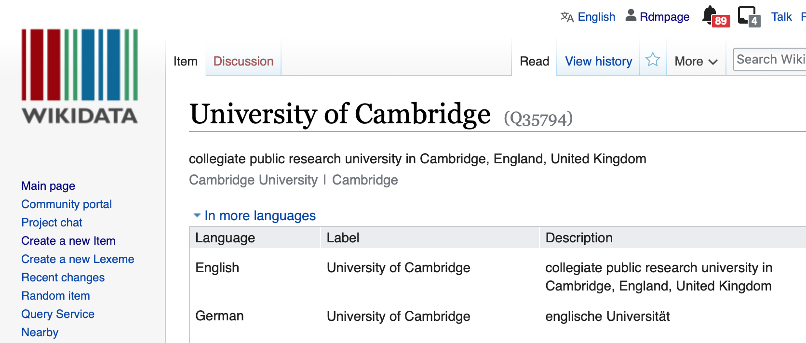
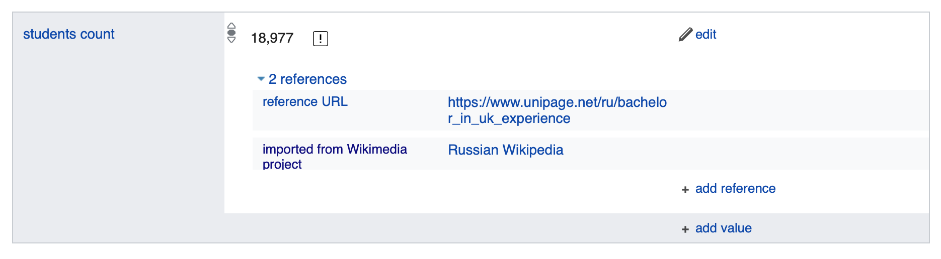

Slide 76
Wikidata
Free, open, community edited database of knowledge
Each fact ideally has a supporting statement (e.g., a reference)
Very powerful (if tricky to learn) query language

Slide 77
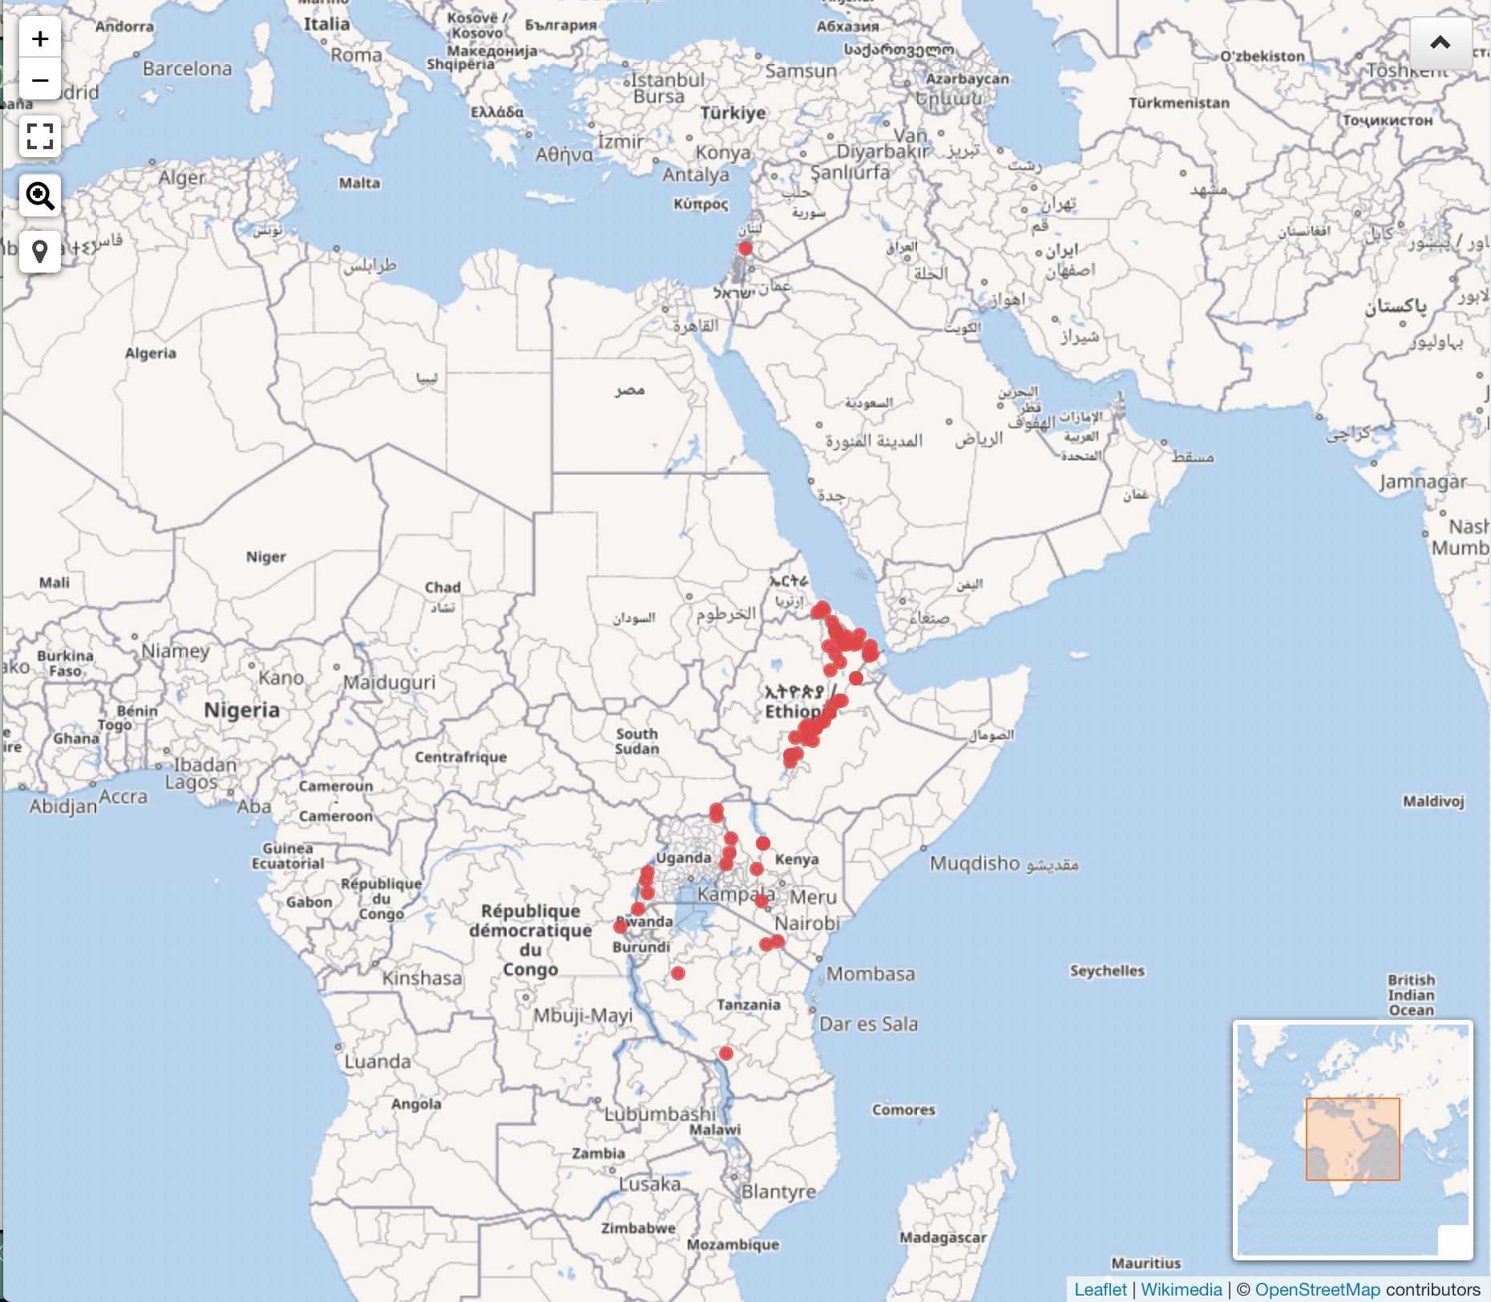
Volcanoes in African Rift Valley
SELECT * WHERE {
?item wdt:P31 wd:Q8502.
?item rdfs:label ?name .
?item wdt:P625 ?geo.
?item wdt:P361 wd:Q81591.
OPTIONAL { ?item wdt:P1886 ?id } .
OPTIONAL { ?item wdt:P2044 ?height } .
OPTIONAL { ?item wdt:P18 ?image } .
OPTIONAL { ?item wdt:P2348 ?erupted . } .
FILTER (lang(?name) = 'en')
}
http://tinyurl.com/y2hryyrm
Notes:
http://tinyurl.com/y2hryyrm

Slide 78
Hummingbirds
Species of hummingbirds (fam: Trochilidae), their genus, and image (if available) according to Wikidata. http://tinyurl.com/ya543y55
https://twitter.com/ReaderMeter/status/1093234198184321024
Dario Taraborelli
@ReaderMeter
Notes:
https://query.wikidata.org/embed.html#%23defaultView%3AGraph%0A%23All%20species%20in%20the%20hummingbird%20(Trochilidae)%20family%2C%20with%20an%20image%20if%20available%0ASELECT%20%3Fitem%20%3FitemLabel%20%3Fgenus%20%3FgenusLabel%20%3Fimage%20WHERE%20%7B%0A%20%20%3Fitem%20wdt%3AP31%20wd%3AQ16521.%0A%20%20%3Fitem%20wdt%3AP105%20wd%3AQ7432.%0A%20%20%3Fitem%20wdt%3AP171*%20wd%3AQ43624.%0A%20%20%3Fitem%20wdt%3AP171%20%3Fgenus.%0A%20%20OPTIONAL%20%7B%3Fitem%20wdt%3AP18%20%3Fimage.%7D%0A%20%20SERVICE%20wikibase%3Alabel%20%7B%20bd%3AserviceParam%20wikibase%3Alanguage%20%22%5BAUTO_LANGUAGE%5D%2Cen%22.%20%7D%0A%7D%0A%0A

Slide 79
What does the future hold?
DOIs for data so that it is citable
Identifiers for people (e.g., ORCIDs) so you get credit for your work
Text mining of papers becomes increasingly common
Getting closer to a biodiversity knowledge graph (Wikidata?)

